Slide 1
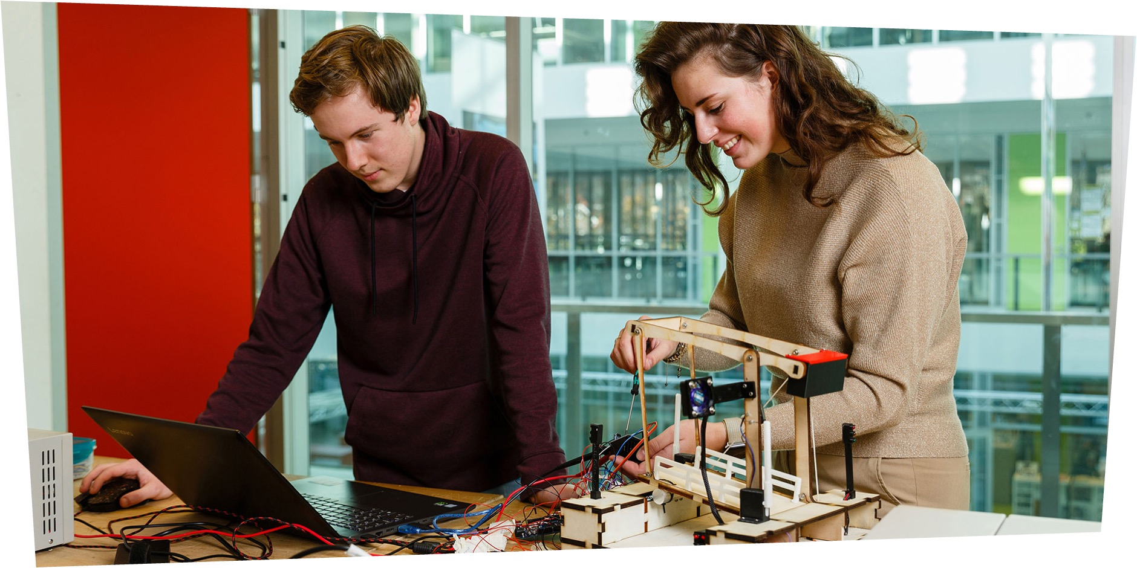
Next Level Engineering
Intake pitch
March 21st 2023

Slide 2
Preparing your intake pitch
B
On the following slides, you will find examples of challenges we work on in the master.
We would like to hear about your approach to these challenges.
Explanation….
Pick a challenge that interests you
Introduce yourself briefly
Show your approach and your contribution to this challenge
You can use the four last slides of this presentation to present yourself and your approach to this challenge. However, feel free to deviate from the format and deliver slides with your personal layout.

Slide 3

Challenges
Potential project challenges
for intake pitch

Slide 4
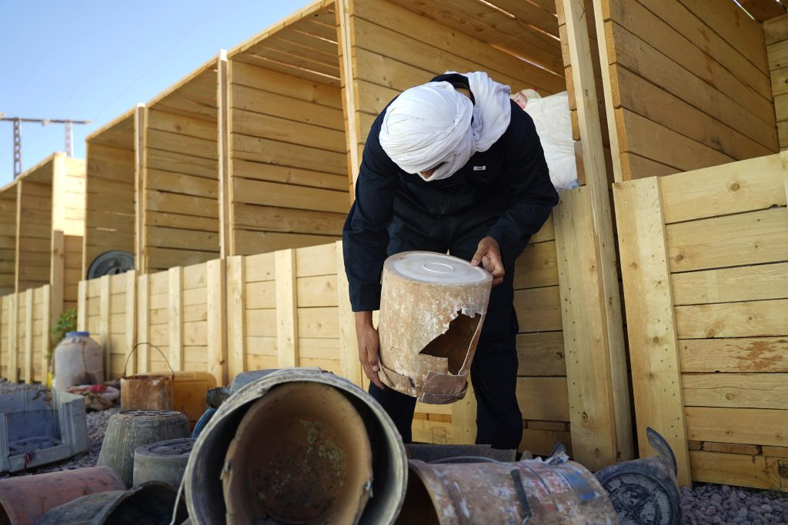
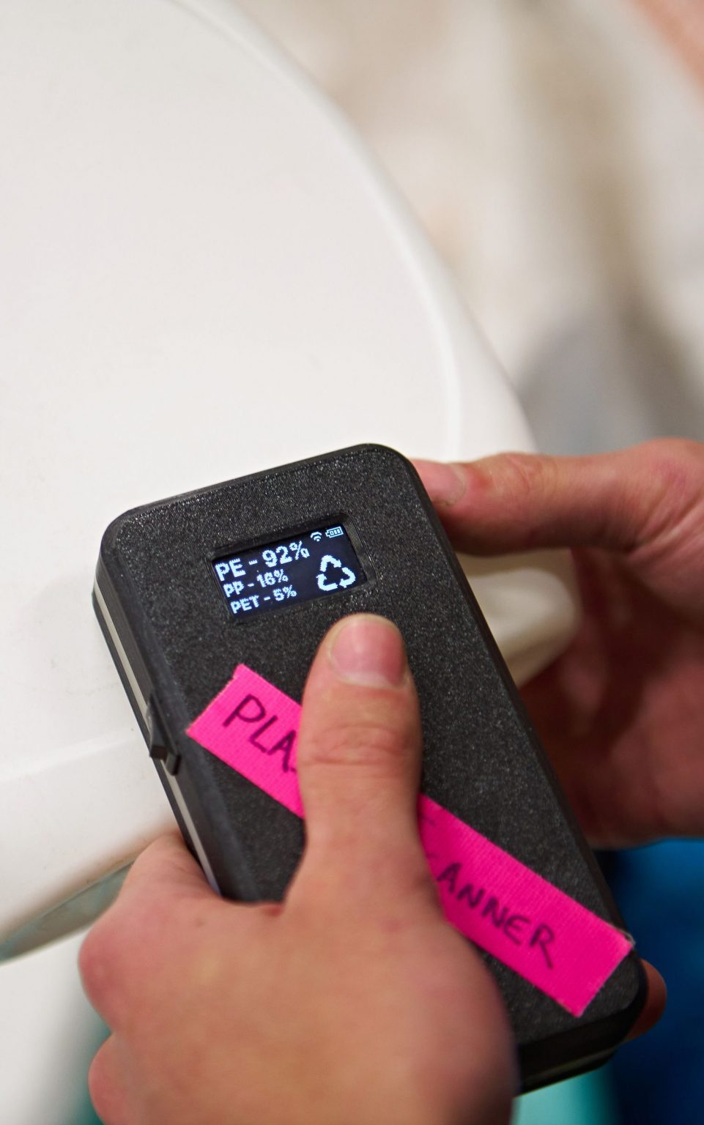

Challenge 1: Plastic Scanner
Plastic recycling in developing countries
Low-cost, hand-held solution to identify plastics
Multidisciplinary questions in Photonics, ChemTech and Artificial Intelligence / Data Science
Give advice on recycling, do experimental research on many different plastics and build a ML model
Make the world a better place!
Plastic Scanner

Slide 5

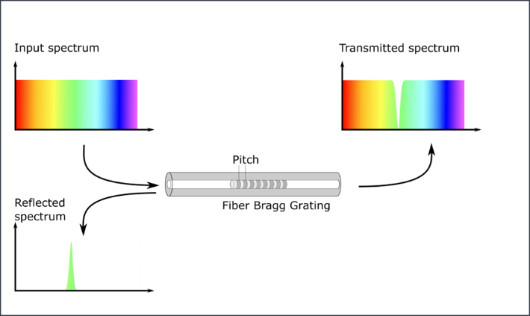
Challenge 2: Structural Health Monitoring with optical sensors
Asset management and maintenance requires monitoring of the ‘structural health’
Aging infrastructure; minimize environmental impact
Fiber optic sensors for measuring e.g. vibrations, tilt and strain: require characterization and calibration
Build experience with application of such sensors and interpretation of generated data
Photonics, Engineering and Fabrication technologies, digital technologies
Less use of resources

Slide 6
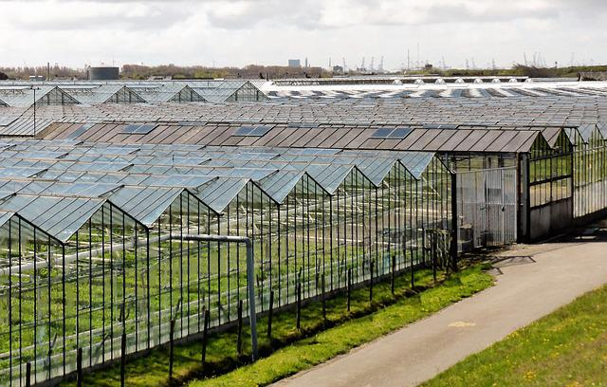

Challenge 3: circular construction at Horti Campus Westland
A
…New 3-hectare campus development in the Westland through reusable building components and secondary materials;
Currently no information on harvestable local materials and their reuse values.
Future-proof building material database for circular construction materials.
Makes use of digital material passport.
Material data decomposition; data mining, data enrichment; to support the use and supply of secondary materials on local site.

Slide 7

Intake pitch
Use the following slides to support your intake pitch

Slide 8

Name surname
B
BSc. Program
Show us something about yourself, your background, your motivation to study Next Level Engineering…
And don’t forget to add a picture.

Slide 9
How would you approach this challenge?
A
Show us how you would go about a project like this…
…

Slide 10
What would be your contribution from your field of expertise to work on the challenge described?
A
Show us how does your background help you work on this challenge...
…

Slide 11
What other fields of expertise can possibly complement your knowledge?
A
Show us how would a multi-disciplinary team help you deal with the challenge...
…

